Slide 1
Multiplying and Dividing Fractions
Ms. Linton
8/18/14

Slide 2
I CAN
Multiply and divide negative and positive fractions

Slide 3
Multiplying
What you know:
$\frac{3}{7}$ · $\frac{5}{2}$ = $\frac{15}{14}$
What you want to find out:
What do you notice about the equation? How did we get the new numerator and denominator?

Slide 4
Rules for Multiplying
$\frac{3}{7}\frac{·5}{·2}$ = $\frac{15}{14}$
Multiply the numerators together. The answer is the new numerator.
Multiply the denominators together. The answer is the new denominator.
It’s that simple!

Slide 5
Dividing
What you know:
$\frac{3}{7}$ ÷ $\frac{5}{2}$ = $\frac{6}{35}$
What you want to find out:
What do you notice about the equation? How did we get the new numerator and denominator?

Slide 6
Rules for Dividing
$\frac{3}{7}÷\frac{5}{2}$ = $\frac{3}{7}·\frac{2}{5}=\frac{6}{35}$
Flip the second fraction (find it’s reciprocal)
Now multiply!
It’s that simple!

Slide 7
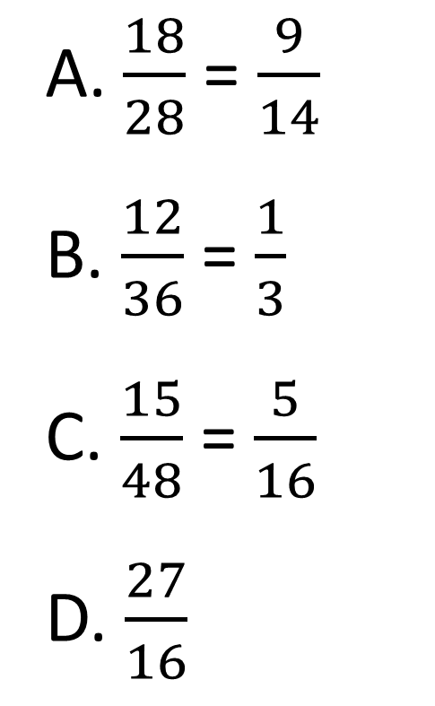
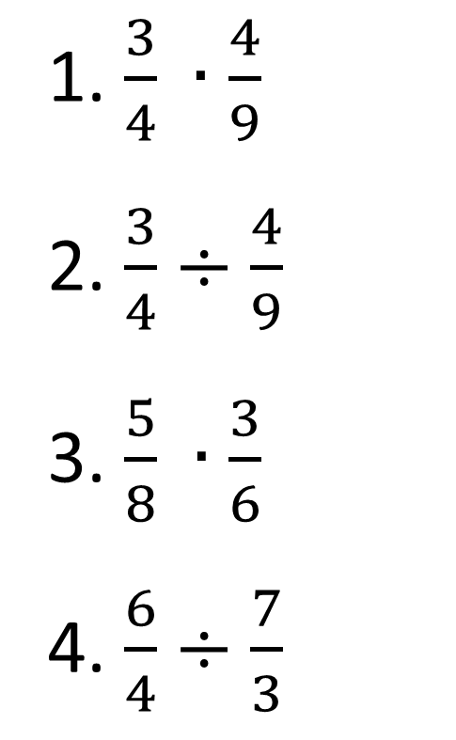
Match the Fractions
Match the equations to their correct answer
1.$\frac{3}{4} ∙\frac{4}{9}$
2. $\frac{3}{4}÷\frac{4}{9}$
3. $\frac{5}{8} ∙\frac{3}{6}$
4. $\frac{6}{4}÷\frac{7}{3}$
A.$\frac{18}{28}$= $\frac{9}{14}$
B. $\frac{12}{36}$= $\frac{1}{3}$
C. $\frac{15}{48}$ = $\frac{5}{16}$
D. $\frac{27}{16}$

Slide 8
Negatives!!!
When multiplying negative fractions, use the same exact rules as multiplying integers
What do you notice about these equations?
$\frac{−3}{6}∙$ $\frac{4}{9}$ = $\frac{−12}{54}$ $\frac{3}{6}∙$ $\frac{4}{−9}$ = $\frac{−12}{54}$ $−$ $\frac{3}{6}∙$ $\frac{4}{9}$ = $\frac{−12}{54}$
Regardless of where the negative sign is, when multiplying a negative and positive fraction, the answer is always negative

Slide 9
Multiplying Negatives Cont.
What do you notice about these equations?
$\frac{−3}{6}∙$ $−\frac{4}{9}$ = $\frac{12}{54}$ $\frac{−3}{6}∙$ $\frac{4}{−9}$ = $\frac{12}{54}$ $−$ $\frac{3}{6}∙$ $\frac{4}{−9}$ = $\frac{12}{54}$
When multiplying two negative fractions, the answer will always be positive.

Slide 10
Dividing Negatives
When dividing negative fractions, use the same exact rules as dividing integers
What do you notice about these equations?
$\frac{−3}{6}÷$ $\frac{4}{9}$ = $\frac{−27}{24}$ $\frac{3}{6}÷$ $\frac{4}{−9}$ = $\frac{−27}{24}$ $−$ $\frac{3}{6}÷$ $\frac{4}{9}$ = $\frac{−27}{24}$
Regardless of where the negative sign is, when dividing a negative and positive fraction, the answer is always negative

Slide 11
Dividing Negatives Cont.
What do you notice about these equations?
$\frac{−3}{6}÷$ $−\frac{4}{9}$ = $\frac{27}{24}$ $\frac{−3}{6}÷\frac{4}{−9}$ = $\frac{27}{24}$ $−$ $\frac{3}{6}÷\frac{4}{−9}$ = $\frac{27}{24}$
When dividing two negative fractions, the answer will always be positive.

Slide 12


Mixed Numbers
When multiplying and dividing with fractions containing mixed numbers, first change the mixed number into an improper fraction
-$2\frac{1}{3} ∙−\frac{3}{6}$
$$−\frac{7}{3} ∙−\frac{3}{6}=\frac{21}{18}$$

Slide 13
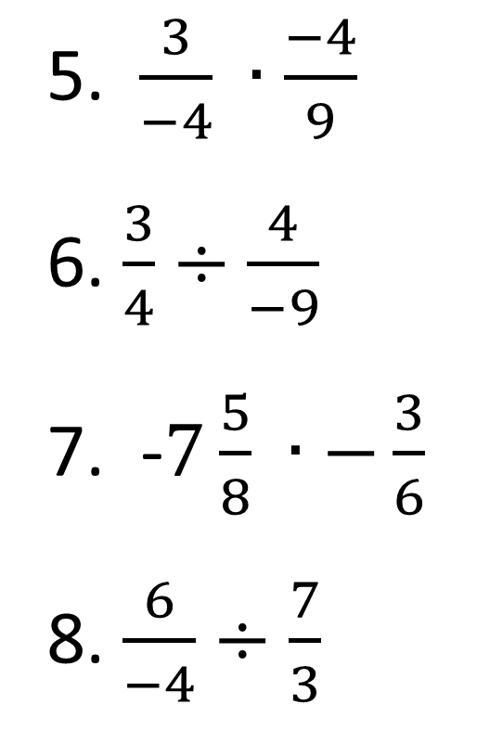

Classify the Fractions
Which of the following answers will be negative?
1.$\frac{−3}{4} ∙\frac{4}{9}$
2. 1$\frac{3}{4}÷−\frac{4}{9}$
3. $\frac{−5}{8} ∙\frac{−3}{6}$
4. $−\frac{6}{4}÷\frac{−7}{3}$
5. $\frac{3}{−4} ∙\frac{−4}{9}$
6. $\frac{3}{4}÷\frac{4}{−9}$
7. -$7\frac{5}{8} ∙−\frac{3}{6}$
8. $\frac{6}{−4}÷\frac{7}{3}$

Slide 14
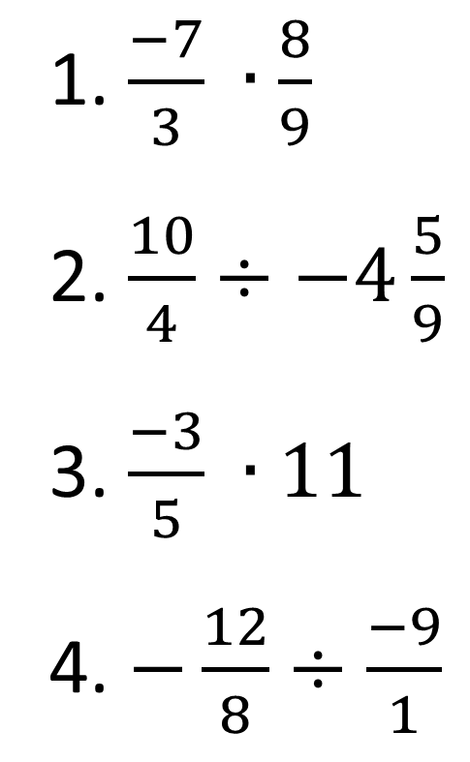
Quick Practice
Solve the equations. CHECK YOUR SIGNS!
1.$\frac{−7}{3} ∙\frac{8}{9}$
2. $\frac{10}{4}÷−4\frac{5}{9}$
3. $\frac{−3}{5} ∙11$
4. $−\frac{12}{8}÷\frac{−9}{1}$

Slide 15
Multiplication Word Problem
Ariel’s English hw is to read 24 pages. She reads 1/8 of the assignment on the bus. How many pages did she read?

Slide 16
Division Word Problem
Joey has 12 ½ yards of material. A cape for a play takes $3\frac{5}{6}$ yards. How many capes can Joey make with the material?

Slide 17
Mixed Review
When adding and subtracting fractions, you must find the ________________ first
For adding negative fractions
When the signs are the same: ______ and keep the sign
When the signs are different: _________ and keep the sign of the ___________ number
For subtracting negative fractions:
The first fraction _____________
Change the minus to _________
Change the sign of the second fraction

Slide 18
Review Cont.
When multiplying fractions:
Multiply the __________ together to get the new numerator
Multiply the __________ together to get the new denominator
When dividing fractions:
_______ the second fraction
Multiply the two fractions

